Slide 1


CompSci club
VIM
Welcome Henry! He is going to take over today’s presentation and discuss Vim with you!

Slide 2

Our person of the day!
Tom Anderson
Perhaps a little bit before our time, but still incredibly influential, today we celebrate the birthday of social networking site MySpace’s co-founder Tom Anderson
Tom would be ubiquitous among MySpace users, being the first “friend” when new profiles were created
Having an interest in technology since he was young, he would hack under the name “Lord Flathead” and prompted the FBI to raid his house when he got into Chase Bank’s security
Even though it has long been surpassed by other social networking sites like Facebook, Instagram and Twitter, the impact of MySpace is hard to understate— it was the first of its kind to reach a global audience and had a tremendous impact on technology, pop culture and music
You could actually code your MySpace profile, introducing a new generation to HTML & coding
Co-Founder of MySpace

Slide 3

Our people of the day
Ken Thompson & Dennis Ritchie
Created a bunch of really influential tech in the 60’s and 70’s
Ken Thompson -> B, Go, UTF-8, Regex, Ed, QED, Belle, Plan 9, Unix
Dennis Ritchie -> B, C, Unix
Created B, C, Go, Unix, Ed, UTF-8, Regex

Slide 4



Roadmap for Today
Vim & Text Editing
Overview of Vim and other editors (editor iceberg)
Hands-on Vim
Get some hands on experience with Vim (replit)
Applications
Discuss applications and use-cases of Vim

Slide 5
Vi Improved baby
Vim &
Text Editing

Slide 6
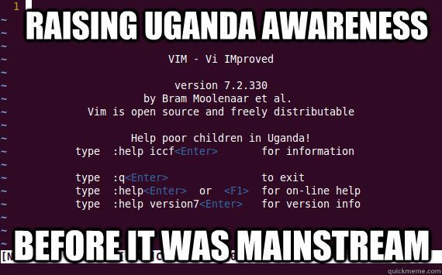
I’ve been using vim for 2 years, mostly because i haven’t figured out how to exit it

Slide 7
Please, don’t use the mouse

Slide 8
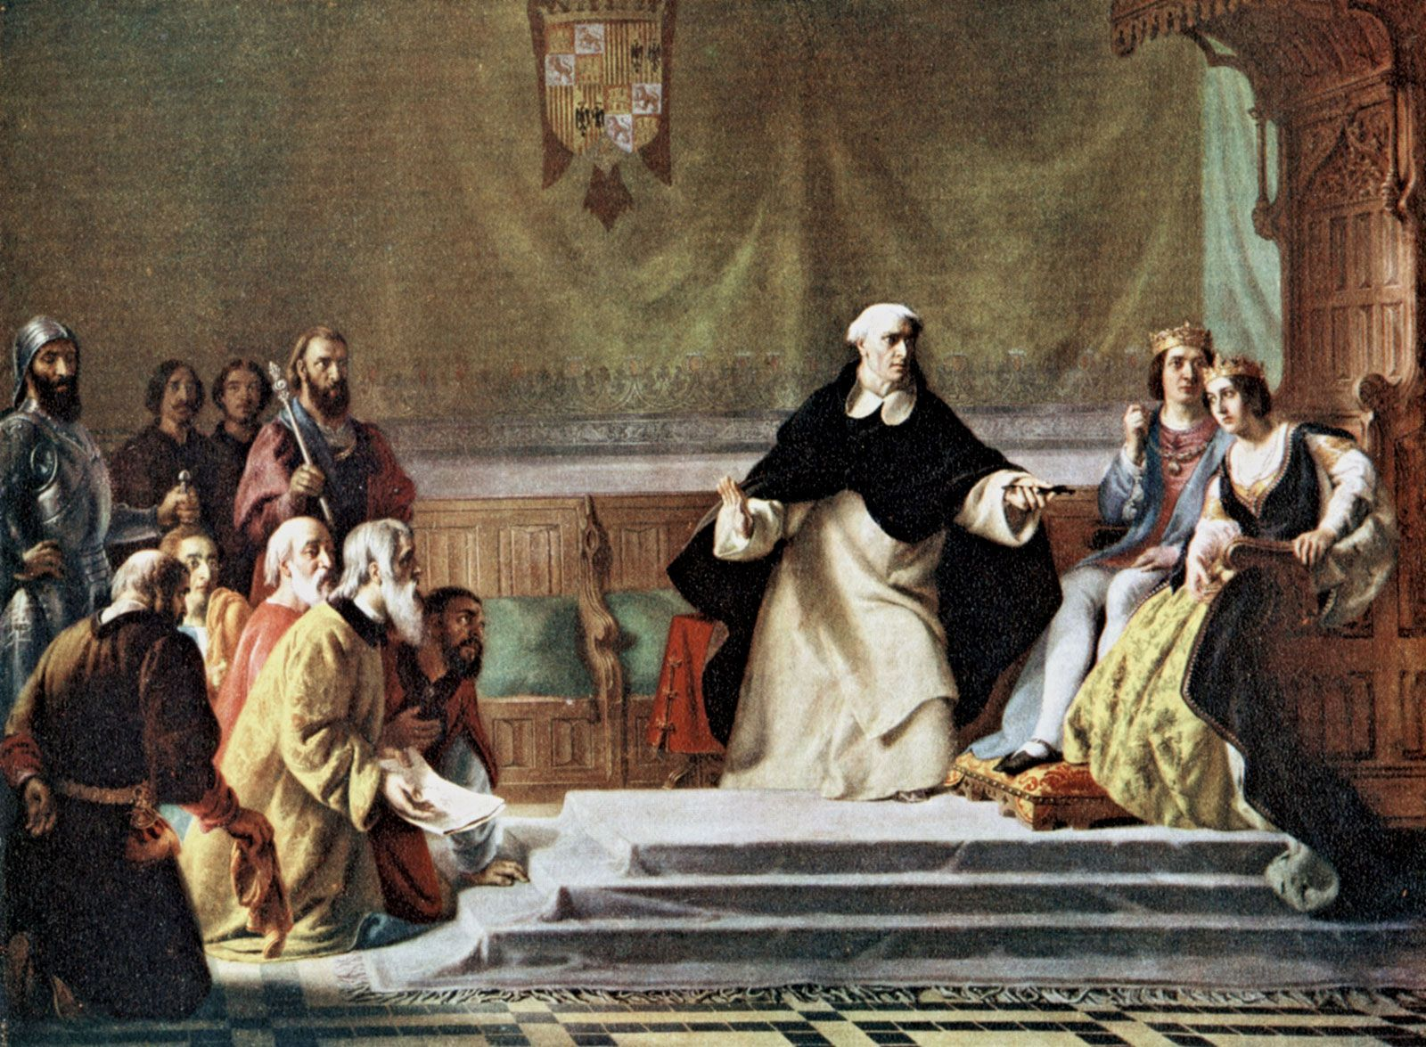


Vim and the spanish inquisition
Highly configurable and extensible text editor (1991)
Based off of vi (1976)
Modal text editor
Blazingly fast text manipulation for 10x silicon sorcerers

Slide 9
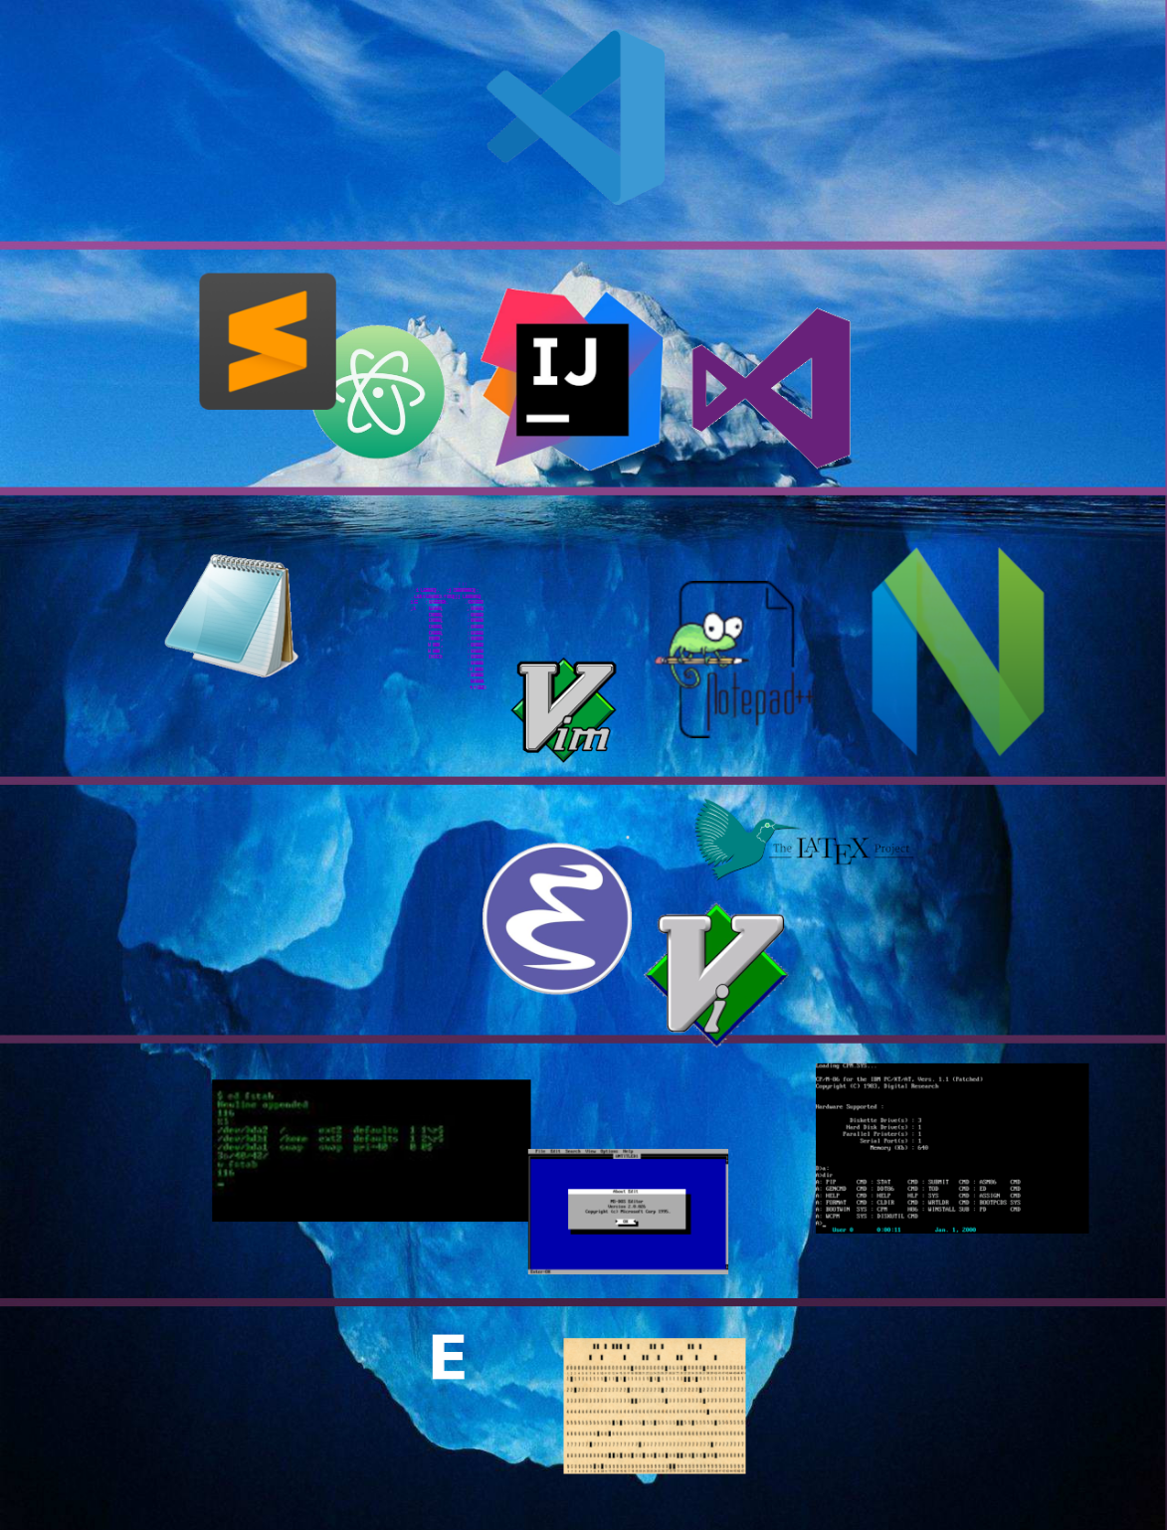

Slide 10
Vim as a Modal Editor
Modal -> Of, relating to, or characteristic of a mode.
Vim has different modes
Normal, Insert, Visual, Command, Terminal
Keys do different things in each of these modes

Slide 11
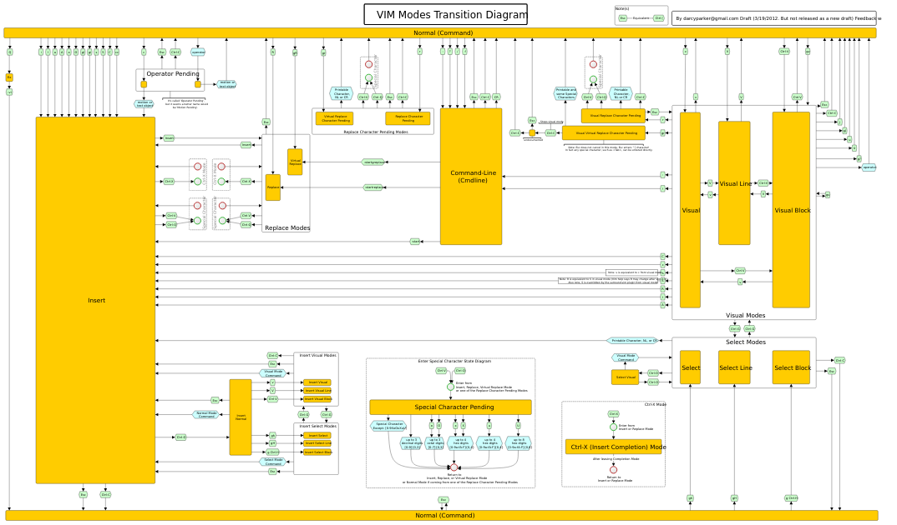
Notes:
This is a joke

Slide 12
Because who doesn’t love some interactivity
Now, moving onto
Hands-on with vim

Slide 13
Basic Commands + (demonstration time???)
h - move the cursor left
j - move the cursor down
k - move the cursor up
l - move the cursor right
w - move forward a word
b - move back a word
i - (NORMAL->INSERT)
<esc> - (INSERT->NORMAL)
v - (NORMAL->VISUAL)
: - (ANY->COMMAND)
Disclaimer: this is a massive oversimplification of the scope and depth of Vim. Also, non-monospaced fonts are evil!

Slide 14
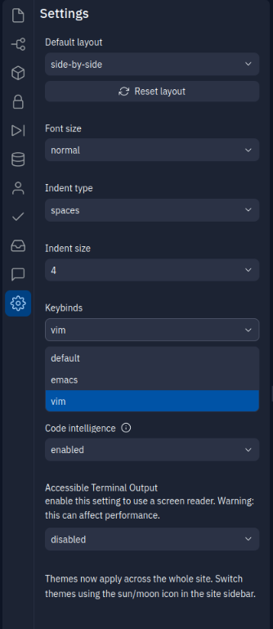
Vim is Ubiquitous (no really it’s everywhere)
Almost every “modern” text editor has a vim motions option
Open a real project (with actual code in it)
Settings>Keybinds>vim
You can now use vim keybindings in Replit :)
An important distinction that many fail to make between Vim and Vim motions
Vim is a text editor
Vim motions are a set of keybindings/shortcuts (these are used everywhere in UNIX-style programs)

Slide 15
Note-taking?!??@?!?
Finally,
Vim Applications

Slide 16
Applications (vimium and beyond!)
Vim (neovim)
Programming
Editing config files, regular stuff
Taking notes (next slide)
Impress ladies with coconut oily, blazingly fast, text editing (actually works)
Vim motions
Web browsing with Vimium (chrome & firefox)
Tiling window manager
Almost every TUI in existence (spotify, calendar, todo)
File managers (i use ranger btw)

Slide 17
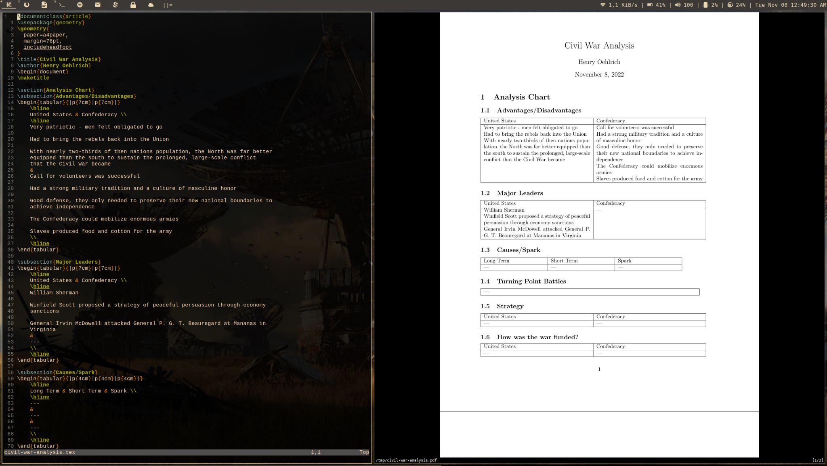

Slide 18
My note taking system (condensed version)
Vim setup -> Nvim, full LSP for markdown, nice remaps, gruvbox (best colorscheme), vimwiki for markdown organization, tree-sitter syntax highlighting, fzf for fuzzy finding
Syntax -> Markdown for most assignments and notes (it’s easy), LaTeX (pdflatex) for any fancy stuff I need to do (tables, slideshows, formulas, etc)
Sync -> I just use a github repo to sync. I only really work on my laptop and chromebook… I don’t mind manually typing out a command once in a while
System -> I really recommend using Linux (it would be so much harder without it), Arch Linux, st (terminal), heavily patched dwm (window manager), xorg (wayland sucks), gruvbox (still best colorscheme), bash (because too lazy to learn zsh), picom (compositing), patched slstatus
Chromebook -> Have to use chromebooks in school, run Linux in a crouton chroot, have basically the same system config as above

Slide 19
Stuff you should check out
https://youtu.be/y6VJBeZEDZU?t=49 -> guy who’s much better than me (would like to watch if time)
https://github.com/neovim/neovim -> most superior vim
https://www.youtube.com/watch?v=X6AR2RMB5tE -> quite new really solid Vim tutorial
https://github.com/vim/vim -> original vim
https://en.wikipedia.org/wiki/Ken_Thompson -> average Unix creator’s wikipedia page
https://vimwiki.github.io/ -> vimwiki (note taking plugin)
https://appletree.or.kr/quick_reference_cards/Unix-Linux/vim-modes-transition-diagram.svg -> diagram

Slide 20
Thank you so much to you guys for being accepting of my ranting. If you have future ideas for a presentation, don’t be afraid to ask and present!
Thank you!
That is all we have for today!

